Slide 1

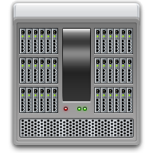
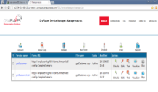




Solution Architecture
Recording test case
EBS/Forms Server
AuraPlayer
Services
Oracle
DB
Notes:
The AuraPlayer server is an EAR file that can be deployed to a Weblogic server
The AuraPlayer service manager can be installed on the existing Forms server machine or on a second server that can access the Oracle Forms server via network.
Any PC that can run Oracle Forms can be used to record an Oracle Forms Scenario. It does NOT need to have Forms developer installed

Slide 2

Solution Architecture
Option A: Load testing using WebLOAD and AuraPlayers’ plugin
EBS/Forms Server
WebLOAD
Plugin
Oracle
DB
Notes:
The AuraPlayer server is an EAR file that can be deployed to a Weblogic server
The AuraPlayer service manager can be installed on the existing Forms server machine or on a second server that can access the Oracle Forms server via network.
Any PC that can run Oracle Forms can be used to record an Oracle Forms Scenario. It does NOT need to have Forms developer installed

Slide 3
Solution Architecture
Option B: Load testing using WebLOAD via AuraPlayer
EBS/Forms Server
WebLOAD
AuraPlayer
Services
Oracle
DB
Notes:
The AuraPlayer server is an EAR file that can be deployed to a Weblogic server
The AuraPlayer service manager can be installed on the existing Forms server machine or on a second server that can access the Oracle Forms server via network.
Any PC that can run Oracle Forms can be used to record an Oracle Forms Scenario. It does NOT need to have Forms developer installed

Slide 4
ServiceManager can be installed on tomcat/weblogic, or on portable server on the user’s desktop
Test case should be created/recorded on ServiceManager (AuraPlayer)
Option A:
  The test case should be exported to 2 files.
  AuraPlayer playback jars files should be installed on WebLOAD
  Playback on Forms would be done from WebLOAD directly (using AuraPlayer’s plugin)
Option B:
  Run HTTP requests from WebLOAD against AuraPlayer ServiceManager
  Playback on Forms would be done from AuraPlayer ServiceManager

